Slide 1
The Continuing
‘Gender Revolution’
in Housework
Jonathan Gershuny*, Oriel Sullivan* and John Robinson**
*University of Oxford
**University of Maryland
May 2014
ACKNOWLEDGEMENTS: We gratefully acknowledge the support of the UK Economic and Social Research Council (grant references ES/L011662/1; ES-060-25-0037, ES-000-23-TO704 and ES-000-23-TO704-A) and the European Research Council (grant reference 339703) for their financial support. We also thank Professor Michael Bittman for enabling Professor Gershuny to conduct analysis on the Australian data in Sydney during January 2013.

Slide 2
Outline of this presentation.
We use the Multinational Time Use Study to provide evidence of historical change in individuals’ work balances.
We present sociological theory (Coleman 1990, Gershuny et al 2005, Sullivan 2006), plus household panel study and time-diary evidence, to reconsider the “stalled revolution” thesis.
We use the British Household Panel Study, the German Socio-economic Panel & the Panel Study of Income Dynamics, to provide evidence of micro-social change mechanisms.

Slide 3
The “Stall” thesis
Recent New York Times articles (Coontz, 2013, Cohen 2014) report that progress in gender equality slowed in the late 1990s and early 2000s.
“Stalling” of change identified in:
women’s employment rates,
gender segregation of school subjects,
attitudes towards gender equality,
division of unpaid labour,
…and related to “gender essentialism”.
(England, 2010; Cotter, Hermsen & Vanneman, 2011)
We’ll focus on paid/unpaid labour balance.

Slide 4
Gender essentialism
A claim of essential differences between men’s and women’s orientation to family and work. Within economists’ rational choice framework, this emerges where otherwise similar men and women make different choices.
Core sociological view: gender is constructed. Gendered behaviours emerge, in real elapsed time, and under specific historical conditions.
Hence, the explicit representation of the passage of historical time in sociological theory.

Slide 5
MTUS Simple File evidence
53 surveys...
… from the 14 countries for which studies were available for more than one decade…
… covering the period 1961-2010…
… and including only the 500,000 days of diary data from respondents aged 20 to 59.

Slide 6
Core housework by gender

Slide 7
All unpaid work by gender

Slide 8
Women’s % of unpaid and all work

Slide 9
MTUS Simple File: findings
Findings:
Continuing gender convergence in paid & unpaid work time.
No systematic gender differences in total work time.
Considerable remaining gender differences in the paid/unpaid balance, perhaps ➔ persistent gender wage gaps (Becker 1991 p56).
What do they tell us?

Slide 10
How do we explain these findings?
Rational choice models don’t really help (dependence on unobserved preference structures leading to indeterminate predictions, absence of historical context, inattention to rates of change, etc)
We need, instead:
Theory recognising both historical time and multi-level interactions of individual agents with social structures (Sullivan 2004, 2006), involving…
…testable mechanisms which explain how individuals’ actions lead to historical change in social structures—and social-structural changes lead in turn to new patterns of action (eg Gershuny et al 1994).

Slide 11
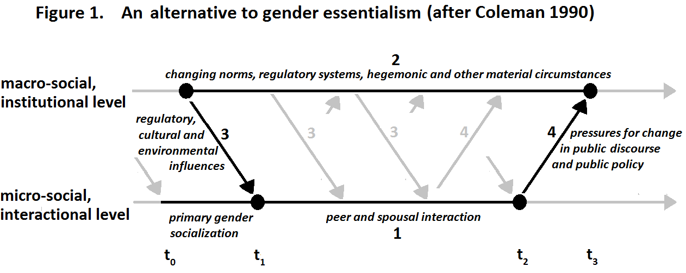
Why women’s actions continue to be different from men’s.

Slide 12
An example of a change mechanism: lagged adaptation

Slide 13
An example of a change mechanism: lagged adaptation

Slide 14
Effects of wife’s employment on division of domestic labour Annual Change in weekly domestic work hours, USA, Germany and UK Q’nnaire “How many hours last week?” data, national representative household panels 1980s-2000. OLS regressions, case = married or cohabiting couple, pooled pairs of successive years. (developed from Gershuny, Bittman and Brice, JMF 2005, Tables 2 and 3)
(* p < .05 ** p < .01) (* p < .05 ** p < .01) | Wife’s year-on-year change in weekly domestic work hours |  |  |  | Husband’s year-on-year change in weekly domestic work hours
Wife’s year-to-year employment status change: | UK BHPS N=16,044 | Germany SOEP N=14,161 | USA PSID N=7,423 |  | UK BHPS N=16,044 | Germany SOEP N=14,161 | USA PSID N=7,423
She stays full time | -0.38 | 0.21 | 2.13 |  | -0.19 | -0.06 | -0.51
Full time➔part time | 1.10 | 2.33 | 1.92 |  | -0.14 | -0.34 | -1.44
Full time➔not empl. | 5.98** | 8.02** | 7.23** |  | -1.44** | -1.76** | -2.48*
Part time➔ full time | -2.50** | -2.21 | 2.65 |  | 0.31 | 0.62 | -0.53
She stays part time | -0.26 | -0.25 | 0.60 |  | 0.18 | 0.23 | -.90
Part time➔not empl. | 2.85** | 2.79** | 2.53 |  | -0.70* | -1.05* | -2.01
Not empl.➔full time | -4.41** | -7.81** | -7.74** |  | 1.75** | 2.59** | 1.71
Not empl.➔part time | -3.57** | -3.79** | -4.68 |  | 0.24 | -.37 | -0.74
She stays not employed | (ref) | (ref) | (ref) |  | (ref) | (ref) | (ref)
(also controlling for husbands’ annual employment change and age of youngest children)

Slide 15
For example: lagged adaptation
Little/no employment ratchet, none in US:
Wife full time ➔ not empl. ➔ +7.23 hours housework for wives
Wife not employed ➔ full time ➔ -7.74 hours for wives
BUT large gender asymmetry, eg Germany:
Wife not employed ➔ full time➔ -7.81 hours housework for wives
Wife not employed ➔ full time➔ +2.59 hours for husbands
Dual burden effects (ft >=30 hrs paid work/week)
Dual burden diminishes over subsequent years
wives’ housework declines, husbands’ increase each year up to 5 years after entry to paid work (Gershuny et al 2005 Table 4).
But adaptation partial, incomplete convergence
US wives’ 2*husbands’ housework, UK 3*, Germany 5*, after 5 years

Slide 16
Summary and conclusions 1
Sociological models (unlike economists’ rational choice approaches) are essentially historical:
Changes in normative structures are necessarily slow; individual practices are to some degree grounded on beliefs about previous states of society, partial knowledge of present circumstances, incomplete understanding of consequences.
Hence outcomes of behaviour are often perceived as unfair or unwanted, and lead to pressure for future compensating change in norms and regulations
In turn, as individual concerns slowly coalesce to shape public discourse, the institutions contributing to societal change (media, interest groups, political parties, public agencies etc.) gradually adjust norms and regulations.

Slide 17
Summary and conclusions 2
The progress of change is not inevitable: specific institutional-level changes are required, to enable and motivate future change for individuals.
For example:
The consequence of the remaining 60/40 gender difference in the paid/unpaid work balance is inequality between men’s and women’s ‘human capital’ (ie earnings capabilities). Hence…
2. … further institutional changes are needed to ‘level the playing field’ for choices of labour market and family formation strategies:
More provision of pre-school childcare facilities.
Tax allowances or public subsidies for these.
Strongly supported gender-neutral parental leave.

Slide 18
Summary and conclusions 3
In short: historical processes of social change should be expected to be slow, and to include periods of levelling-off (even reversal).
So we should wait to make judgements about stalling, and ‘essential’ gender differences!

Slide 19
References
Becker, Gary S, A Treatise on the Family, Harvard University Press, enlarged edition 1991.
Burda, Michael, Daniel S Hamermesh and Philippe Weil. (2013). “Total Work and Gender: Facts and Possible Explanations” Journal of Population Economics 26(1), 239-261.
Cohen, Philip, N. “How can we Jump-start the Struggle for Gender Equality?” New York Times Opinion Pages: 23rd November
Coleman, James S (1990) Foundations of Social Theory Cambridge, Massachesetts : The Bellknap Press of Harvard University Press
Coontz, Stephanie (2013) “Why Gender Equality Stalled”. New York Times Sunday Review: 16th February
David Cotter, Joan M. Hermsen, and Reeve Vanneman (2011), “The End of the Gender Revolution? Gender Role Attitudes from 1977 to 2008”. American Journal of Sociology, Vol. 117, No. 1 pp. 259-289
England, Paula (2010). “The Gender Revolution : Uneven and Stalled”. Gender & Society pp. 24-149
Gershuny, Jonathan, Michael Godwin and Sally Jones (1994) "The Domestic Labour Revolution: a Process of Lagged Adaptation" in M. Anderson, F. Bechhofer and J. Gershuny (eds) The Social and Political Economy of the Household. Oxford: Oxford University Press/
Gershuny, Jonathan Michael Bittman and John Brice (2005) “Exit, Voice and Suffering: Do Couples Adapt to Changing Employment Patterns?” Journal of Marriage and Family Vol 67 (August): pp 656-665.
Sullivan, Oriel (2004) ‘Changing gender relations within the household: a theoretical perspective’. Gender & Society 18/2, 207-223
Sullivan, Oriel (2006) Changing Gender Relations, Changing Families: Tracing the Pace of Change. New York: Rowman and Littlefield (Gender Lens Series), pp. 141

