Slide 1
85 YEARS OF US RURAL WOMEN’S TIME USE Teresa Harms and Jonathan Gershuny Centre for Time Use Research University of Oxford
ACKNOWLEDGEMENTS: We gratefully acknowledge the financial support of the UK Economic and Social Research Council (grant references ES/L011662/1; ES-060-25-0037, ES-000-23-TO704 and ES-000-23-TO704-A), the European Research Council (grant reference 339703) and the University of Oxford John Fell Fund.

Slide 2
Outline of presentation
The presentation falls into two parts:
An outline of the procedures used to revive the micro-data from the 1920s USDA diary studies of women’s time use.
A first application of this material, comparing it with the rural women from 1975 Michigan National time diary study and the ATUS 2003-10, to reconsider the Vanek/Cowan “housework still takes time” thesis.

Slide 3
Background to study
The Morrill Land Grant College Act of 1862 supported the establishment of US state colleges for agriculture and the Hatch Act (1887) the development of state agricultural experiment stations. The Smith-Lever Act (1914) created a Cooperative Extension Service associated with each US land-grant institution.
The 1925 Purnell Act, with a focus on agricultural economics and rural sociology, enabled the US Department of Agriculture (USDA) to collect evidence of farm women’s time use across a number of state agricultural experiment stations.
Dr Hildegard Kneeland, a Home Economist employed by the US Bureau of Economics conducted diary surveys from ‘farm’, ‘town’ and ‘college’ women for comparative purposes. Her 1929 Annals article sets out a modern case for accounting extensions to recognise women’s unpaid domestic work.
Published tabular results from the original USDA researcher-produced summaries has been used (in Vanek 1974, 1978; Ramey 2009) but the individual-level micro-data have not been available until now for analysis.

Slide 4
Materials so far recovered
Originally >1500 women ‘farm’ and ‘town’ were surveyed across the United States. The recovered material includes:
Researcher-produced diary-based weekly minutes summary tables in 60 activities, plus weekly help totals in various specific household tasks) for 566 farm and other rural women mainly from New York, California and Michigan States.
Seven-day own-words diaries, detailed supplementary questionnaires (household composition and characteristics, appliances, equipment) and researcher-produced summary sheets for 77 ‘College’ women (Kneeland’s study).
We have digitised all of the recovered records by scanning them and entering the data into a large database ready for analysis (SPSS, STATA).

Slide 5
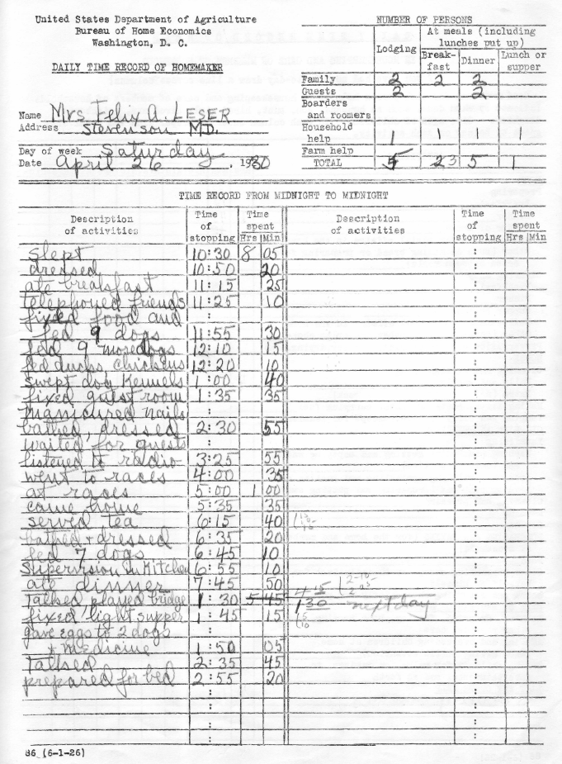
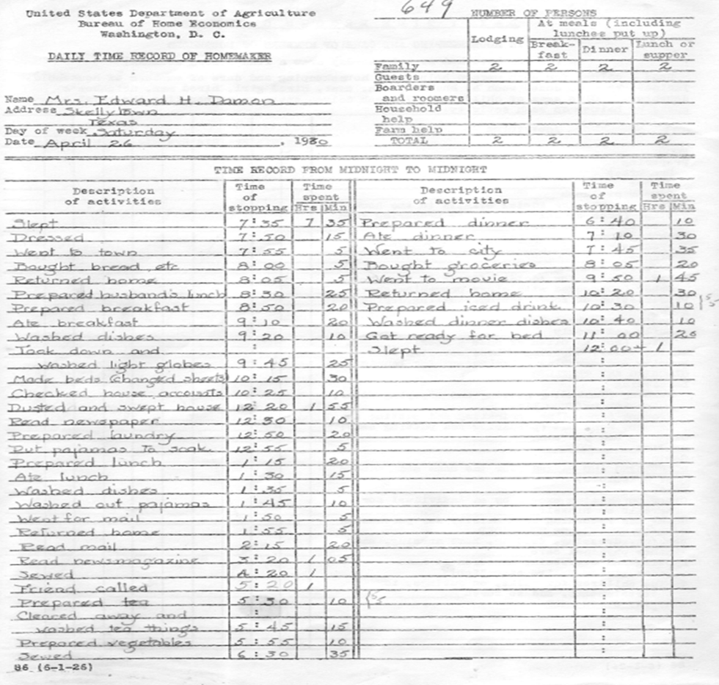
Examples of 7-day own-words diary (1930)

Slide 6
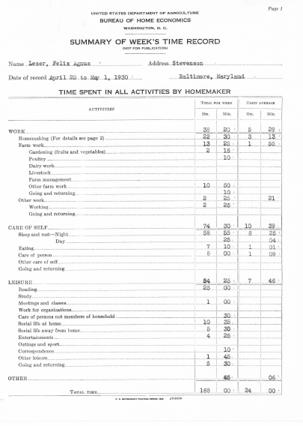
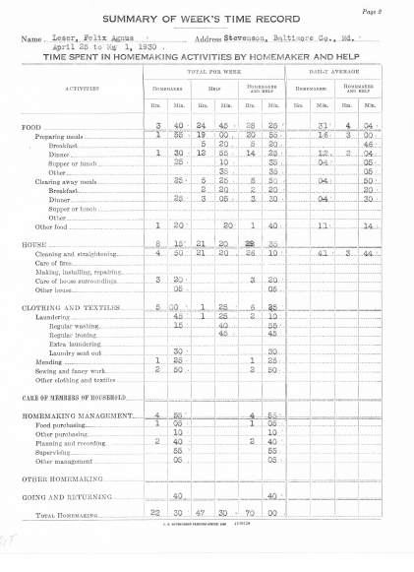
Example of USDA researcher-produced ‘summary record’

Slide 7
Methods for identifying women’s individual and household characteristics
Family and given names/initials and address were attached to the 566 USDA researcher-prepared aggregate summaries.
These were matched to records in ‘Ancestry.com’ including:
US Federal Census micro-data to 1940 (70-year embargo in US)
Birth, Death & Marriage Indexes
Voting Registers (mainly Californian)
Social Security Numbers
City Directories
Military records (including drafts)
Immigration & travel documents (passport applications, etc.)
Other material (obituaries, newspaper articles, photographs, etc.)

Slide 8
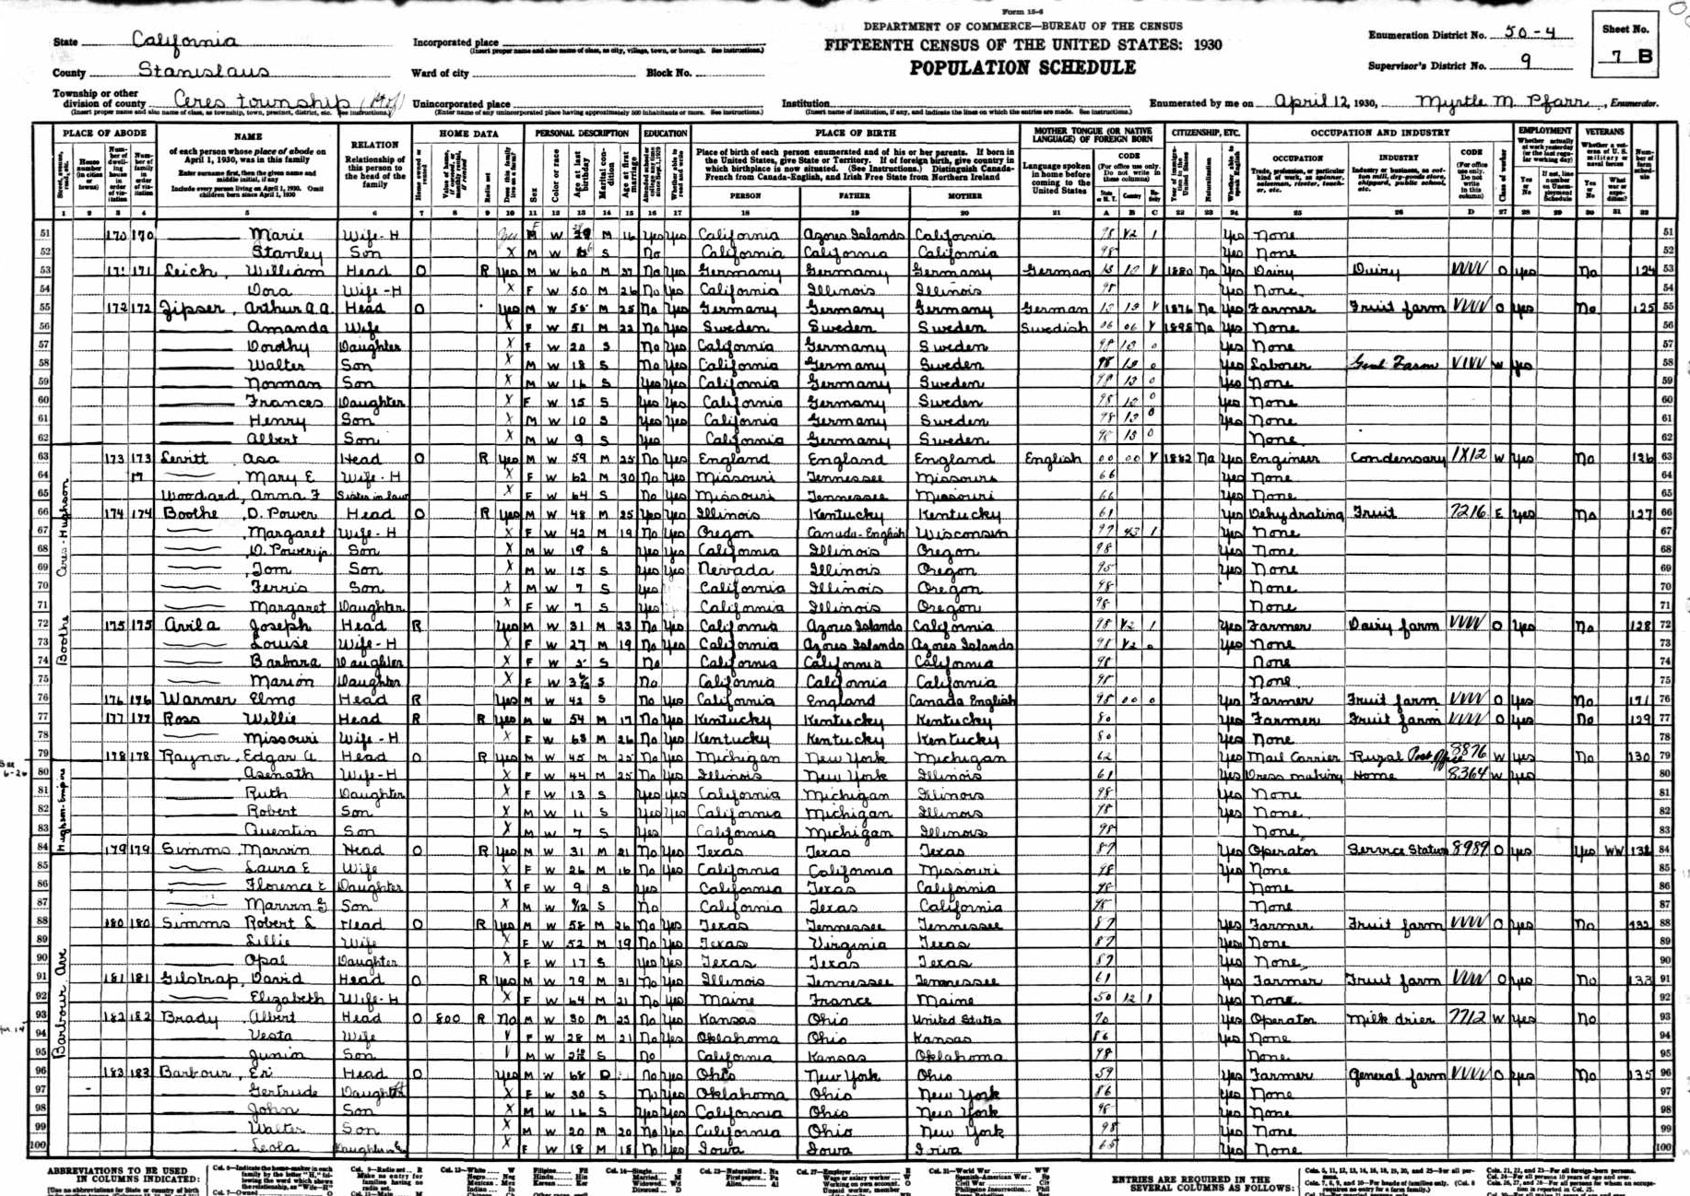
US Federal Census 1930

Slide 9
Census database variables
For diarist and husband data from two censuses (mainly 1920 & 1930).
‘Farm’ & ‘town’ women’s family characteristics derived from household census record (husband head of household in 1920 census).
94% of aggregate records matched to census records.
Census Roll and Enumeration District | Children living in household (name/age/sex)
Address at Censuses and USDA Survey | Other household members (parents/step-children/other family/ servants/lodgers)
Rent/own/live in parents’ or relatives’ home/other | Place of birth (diarist, husband and parents)
Live on farm? | Race/immigrant/dates of immigration/naturalised?/mother tongue
Own radio? (1930 census) | War veteran (WW1/Spanish American War)
Occupation & industry | Birth & Death Index
Employed at Census? | Maiden name of diarist
Attended College at Census? | Remarks

Slide 10
Farm or town samples?
 | Is the diarist's husband a farmer?
Farmer by occupation? | Not | Possibly | Probably
 | (farmer in neither census) | (farmer in one census) | (farmer both censuses) | Total
domicile, nearest census:
not recorded |  | 1 |  | 1
not living on farm | 110 | 53 | 10 | 173 | 33%
living on farm | 32 | 144 | 178 | 354 | 67%
total | 142 | 198 | 188 | 528
 | 27% | 38% | 36%

Slide 11
N and age-distributions, US diary samples
Age Group | USDA |  | AHTUS rural women
 | N | %________________________________
 | 1920s | 1920s | 1965 | 1975 | 1985 | 2003-
16-19 | 3 | 0.6 | 2.0 | 2.9 | 0.8 | 0.7
20-29 | 70 | 13.3 | 26.9 | 27.4 | 19.9 | 16.7
30-39 | 203 | 38.5 | 24.9 | 21.9 | 27.2 | 25.8
40-49 | 162 | 30.7 | 20.9 | 16.8 | 22.2 | 26.0
50-59 | 67 | 12.7 | 21.7 | 20.8 | 23.4 | 22.2
60-65 | 22 | 4.2 | 3.6 | 10.3 | 6.5 | 8.7
 | 1 | Missing
Total N | 528
N of days | 3696 |  | 249 | 982 | 261 | 5331

Slide 12
The housework time “paradox”
The claim that dissemination of domestic “labour saving” equipment does not in fact save labour is very durable. (Mokyr (2000) calls this finding the ‘Cowan paradox’, after Schwartz-Cowan (1980)—tho’ her book does not make this claim.) Source is a 1974 Scientific American article based on tables from the USDA diaries. Opening sentence:
“As one might expect, working women spend less time in housework than their mothers and grandmothers did some 50 years ago. Women who are not in the labor force however, spend just as much time”.
Vanek (1974, p. 116, our emphasis)
However once she turns to discussing the evidence, her term shifts to “household work”—which includes childcare and shopping!
Irrespective of terminology, we see two key problems with her finding:
A potential selection bias effect that results from Vanek’s focus on “women who are not in the workforce”.
The “X-section difference = change” fallacy (not explored here).

Slide 13
A selection bias effect
A process leading to historical growth in household workload of both employed and non-employed women
Assume, other things being equal:
women’s P_{empl} inversely related to unpaid workload
growing acceptability of women’s paid work
i.e. P_{empl} increases over time at each workload level
➔ The mean workload level of non-employed women rises over historical time (as does that of employed women). Both groups have on average more unpaid work to do even if total workload remains unchanged (because of proportional shift into employment).

Slide 14
What do we expect to find?
Vanek’s claims (1920s to 1965):
Increase in household work time for non-employed women.
A difference in housework trends between employed and non-employed women.
We are looking for:
Longer-term evidence that labour-saving domestic equipment fails to save unpaid labour time.

Slide 15
farm or
paid work

Slide 17
Rural married women’s unpaid work minutes per day
OLS models p= .0005 *** p=.005 ** p=.05 *
 | cooking |  | other domestic |  | clothes care |  | shop, admin |  | care of persons |  | all unpaid
Multiple R | 0.46 |  | 0.31 |  | 0.34 |  | 0.16 |  | 0.50 |  | 0.42
(age & squared, N kids, age youngest child, interactions) | …….. |  | ……… |  | ……. |  | ……. |  | ……. |  | …….
economically active | -2.3 |  | -9.1 |  | -28.4 | *** | -3.8 |  | -10.5 |  | -54.1 | **
econ. active*1975 | -29.0 | *** | -33.4 | ** | 7.0 |  | -15.8 |  | -17.2 |  | -88.6 | **
econ. active*2003- | -14.0 | * | -27.7 | ** | 21.6 | *** | -8.0 |  | -24.3 | * | -52.5 | **
Surveyed 1975 | -40.7 | *** | -44.2 | *** | -65.1 | *** | 69.8 | *** | 24.6 | * | -55.6 | **
Surveyed 2003-11 | -77.3 | *** | -74.7 | *** | -83.5 | *** | 76.8 | *** | 36.5 | * | -122.2 | ***
(Constant) | 96.2 | *** | 126.3 | *** | 87.5 | *** | 25.7 |  | -18.7 |  | 317.1 | ***

Slide 18
none
none

Slide 19
3, 3
1, 3

Slide 20
Why are these changes happening?
Is it because of change in population characteristics (e.g. age distributions, age and N of children, proportion of women in employment)?
Is it change in behavioural propensities (i.e. people with particular characteristics do different things with their time.)
Or is it both changing in the same direction at the same time?

Slide 21
Oaxaca decomposition of OLS regression
historical change in time in an activity
= intercept change effects + coefficient change effects
+ means change effects + interaction change effects
Dependent Y^{i}_{t=1}-Y^{i}_{t=0} , n independent vars in an OLS regression:
intercept effects= int^{i}_{t=1} - int^{i}_{t=0}
coefficient effects= sum_{j=1}^{n}(Ẋ^{ij}_{t=0} * (b^{ij}_{t=1} - b^{ij}_{t=0}))
mean effects= sum_{j=1}^{n}(b^{ij}_{t=0} * (Ẋ^{ij}_{t=} - Ẋ^{ij}_{t=0}))
interaction effects= sum_{j=1}^{n}((b^{ij}_{t=1} - b^{ij}_{t=0})*(Ẋ^{ij}_{t=1} - Ẋ^{ij}_{t=0}))
“behavioural propensity change”
= intercept effects + coefficient effects
Bianchi et al (2001 p.211)

Slide 22
Proportion of all historical change in time use related to behavioural propensities
 | 1920s-1975 | 1975-2000s | 1920s-2000s
cooking | 90% | 94% | 95%
other domestic | 120% | 83% | 173%
clothes care | 96% | 97% | 99%
shopping | 110% | 129% | 105%
child & adult care | 139% | 111% | 129%

Slide 23
Findings
In relation to the Vanek thesis:
Decreasing total household work time for almost all groups of women.
No difference in trends between employed and non-employed.
Dominance of behavioural change consistent with common-sense expectation from labour-saving equipment.

Slide 24
Findings
In relation to the Vanek thesis:
Decreasing total household work time for almost all groups of women.
No difference in trends between employed and non-employed.
Dominance of behavioural change consistent with common-sense expectation from labour-saving equipment.
In relation to 1920s USDA time-diary data:
The addition of census and other contextual data to micro-level diary material produces a useable dataset….
….which (partially) extends the AHTUS backwards by 40 years.

Slide 25
References
Bianchi, Suzanne M., Melissa A. Milkie, Liana C. Sayer & John P. Robinson (2000) “Is anyone doing the housework? Trends in the gender division of household labor”, Social Forces 79 (1): 191-228.
Kneeland, Hildegarde (1929) “Woman's economic contribution in the home”, Annals of the American Academy of Political and Social Science, 143: 33-40.
Mokyr, Joel (2000) "Why "More Work for Mother?" Knowledge and Household Behavior, 1870-1945." The Journal of Economic History 60 (1): 1-41.
Cowan, Ruth Schwartz (1983) More work for mother: The ironies of household technology from the open hearth to the microwave. New York: Basic Books.
Ramey, Valerie. A. (2009) “Time spent in home production in the Twentieth-Century United States: New estimates from old data”, The Journal of Economic History, 69 (1): 1-47.
Vanek, J. (1978) “Household technology and social status: Rising living standards and status and residence differences in housework”, Technology and Culture, 19 (3): 361-375.
Vanek, J. (1974) “Time spent in housework”, Scientific American, 5 (231):116-120.

